Slide 1
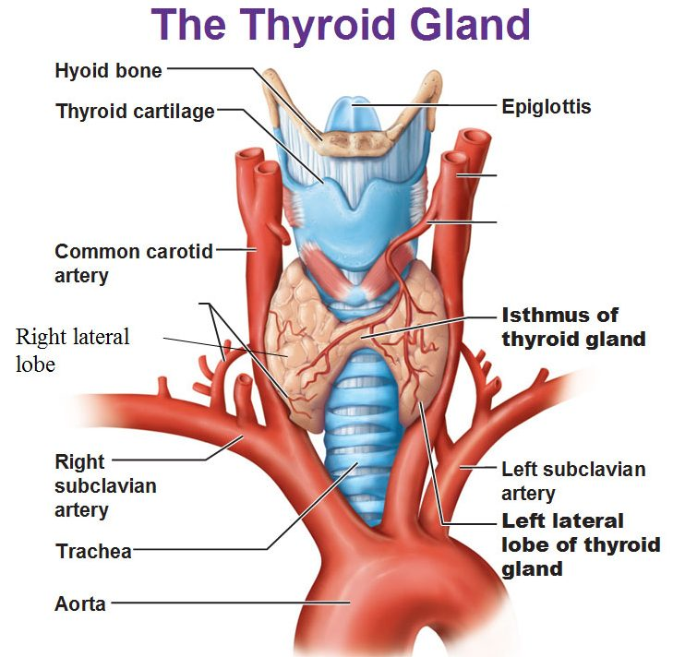
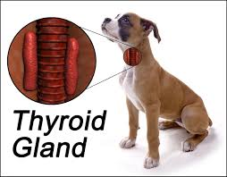
Thyroid gland

Slide 2
Thyroid gland
Is a butterfly –shaped structure located on the ventral surface of trachea .
His secreted 2 hormones :
Tetraiodothyronine T4,
Triiodthyronine T3 .and
Calcitonin .

Slide 3
Thyroid gland
The thyroid hormones regulate the body's metabolic rate and are necessary for normal growth and development .
Calcitonin regulates Ca level in the blood .
Thyroid hormones required for the synthesis of growth h. and genera permissive for its action , and it is also required foe GH to exert its effects on target tissue .

Slide 4
Thyroid gland synthesis and secretion of thyroid H.
The thyroid gland contains numerous spherical follicles each of which is compose of a single layer of secretory cells , called follicular cells , surrounding a glycoprotein the follicular cells secrete called colloid.
TH hormones are synthesized in the follicles .
C cells :
are located in the interstitial space between the follicles , which is synthesize and secrete calcitonin .

Slide 5
Thyroid gland synthesis and secretion of thyroid H.
Thyroglobulin TG:
The primary substance found in the colloid , is protein that function as the precursor molecule for thyroid H.
Also located in the colloid are the enzymes required for thyroid H. synthesis and iodide (ionized form of iodine ) .
The thyroglobulin and enzymes are synthesized in the follicular cells and secreted into the colloid by exocytosis.
All component of thyroid H. synthesis located in the colloid .

Slide 6
Thyroid gland steps of thyroid H. synthesis and secretion
1)
Tyrosine + thyroglobulin = iodinated
Iodinated + iodide = monoiodotyrosine (MIT)
(MIT)+ second iodide =diiodotyrosine(DIT)
2) Two iodinated tyrosine MIT &DIT on the same TG are coupled at which time the 2 tyrosine are linked together by covalent bond
T4 &T3 are the thyroid H. , although at this step they are still attached to TG

Slide 7
Thyroid gland steps of thyroid H. synthesis and secretion
3) Thyroid H. are stored in the colloid bound to TG for up to 3 months until release .
4) TSH arriving via the blood stream stimulates release of thyroid H.
TSH bind to the receptors on the membrane of follicular cells , activated by cAMP second messenger system

Slide 8
Thyroid gland steps of thyroid H. synthesis and secretion
5) The follicular cells taken iodinated TG molecules from the colloid by phagocytosis .
6) The phagosome containing the iodinated TG fuses with the lysosome .
7) Exposure of the TG molecule to lysosomal enzymes that break down the TG causes the release of T3&T4 into the follicular cells .

Slide 9
Thyroid gland steps of thyroid H. synthesis and secretion
8) Because T3 & T4 are lipophilic , they can diffuses across the plasma membrane and into the blood stream , where they are:
Selectively bound by protein carriers that include thyroxin – binding globulin and transthyrethin and
Non selectively bound by albumin .

Slide 10
Thyroid gland steps of thyroid H. synthesis and secretion
T4 is normally produced and secreted at a rate about 10 times greater than T3 .
T3 is approximately 4 times more potent at the target tissues .
Most of the T4 that is secreted into the plasma is eventually converted by the liver , kidneys or target tissue to the more active T3.
In fact the majority of T3 in the plasma is synthesized from circulating T4 conversion of T4 to T3 is called activation .

Slide 11
Thyroid gland steps of thyroid H. synthesis and secretion
TH levels are virtually constant under normal condition because the primary control of its secretion occur via negative feedback .
TH secretion is stimulated by TSH from the anterior pituitary gland

Slide 12
Thyroid gland action of thyroid hormones
Thyroid H. Are lipophilic and thus easily cross membrane , and receptors' for thyroid H. are in the nuclei of target cells .
Binding of thyroid hormones to receptors alters the rate of transcription of mRNA from DNA .
the primary action of the thyroid hormones is to raise the body basal metabolism rate that is increase the rate of O2 consumption and energy expenditure at rest .

Slide 13
Thyroid gland action of thyroid hormones
Thyroid H. stimulated increase in metabolism occur in most (but not all) tissue of the body .
Notable exception are brain , spleen , and gonads.
One way in which TH . increase metabolism is an increase in the rate of Na/K pump actively in cells .

Slide 14
Thyroid gland action of thyroid hormones
As ATP is hydrolyzed during activity of Na/K pump, hear is liberated
ATP is used up, necessitating higher rates of fuel oxidation & ATP production which generate even more heat.
Thyroid hormones also promote increased numbers of mitochondria in cells in concentration of certain enzymes involved in oxidation phosphorylation.

Slide 15
Thyroid gland action of thyroid hormones
Thyroid hormones also promotes increased energy mobilization when present in higher than normal concentration by promoting glycogenolysis, conversion of muscle protein to amino acids, and lipolysis.
They also promote gluconeogenesis and ketone synthesis
Conversely, at lower than normal concentration, thyroid hormones have opposite effect, promoting glycogenesis and protein synthesis.

Slide 16
Thyroid gland action of thyroid hormones
Thyroid hormones promote the synthesis of beta adrenergic receptors.
Adrenergic receptors bind epinephrine & norepinephrine, the chemical messenger of sympathetic nervous system.
Thyroid hormones permit many tissues to respond to sympathetic neural input and to circulatory epinephrine

Slide 17
Thyroid gland action of thyroid hormones
Thyroid hormones are necessary for normal growth and development of many tissues, and for maintaining normal function after growth has ceased.
Many of these effects are mediated through stimulation of GH release ( in synergism with glucocorticoids) and permissiveness to GH in target tissues.
Infants, thyroid hormone deficiency can lead to form of irreversible brain damage called cretinism, in which mental development is retarded and growth is stunted.

Slide 18
Thyroid gland action of thyroid hormones
In cretinism, axons and dendrites nerve cells are poorly developed and myelination of axons is defective
Cretinism can be prevented by early diagnosis of hypothyroidism and initiation of T3 replacement therapy.
In adult, thyroid hormone deficiency lead to impairment of mental function but defects are fully reversible upon restoration of normal thyroid hormone level.

Slide 19
stress
Cold tempreture alter
hypothalamus
TRH secretion
Anterior pituitary gland
TSH secretion
Thyroid gland

Slide 20
Thyroid gland
T3 secretion n
T4 secretion
Plasma T3
Conversion T3
Many tissue
Nervous system
Basal metabolic rate
Heat production
Respiratory rate
Sympathetic output
Primit normal growth and development
Permits maintenance of normal activity

